Slide 1
SECURE DATA HIDING IN IMAGES USING STEGANOGRAPHY
CAPSTONE PROJECT
Presented by
Student Name : Selvaraj S
College Name: Gnanamani college of technology
Department : B.E Computer Science and Engineering

Slide 2
OUTLINE
Problem Statement
Technology used
Wow factor
End users
Result
Conclusion
Git-hub Link
Future scope

Slide 3
PROBLEM STATEMENT
Steganography is the technique of hiding data in digital media like images, offers a solution by embedding hidden messages without altering the visible appearance of the image. However, there is a need for enhanced security to prevent unauthorized access, detection, or manipulation of the hidden data. This project leverages python to securely hide data within images using a combination of steganography techniques and encryption, ensuring both invisibility and confidentiality.

Slide 4
TECHNOLOGIES USED
Python: The primary language for building the system due to its simplicity and efficiency in working with image and data manipulation.
OpenCV (cv2): For image processing tasks such as loading, displaying, and saving the image. OpenCV helps to manage pixel-level manipulations.
NumPy: To handle image data efficiently, perform matrix operations, and manage pixel manipulation in the image.
OS: Used for file handling tasks, including reading/writing data to/from the system and managing image paths.

Slide 5
WOW FACTORS
Invisible Communication: The technique enables data hiding without noticeable changes to the image, making it nearly impossible for casual observers to detect the hidden data.
Data Privacy: Protect personal or confidential data by hiding it in images.
Covert Communication: Use this technique in secure and private messaging.
Flexibility: Can hide any form of data (text, file, etc.) within images.

Slide 6
END USERS
Individuals: Users who need to send private or encrypted messages without the risk of detection.
Organizations: Companies that want to protect sensitive business data or intellectual property.
Artists & Photographers: Embed watermarks or copyright information in images.
Government & Security Agencies: For covert communication or secure transfer of classified information.

Slide 7
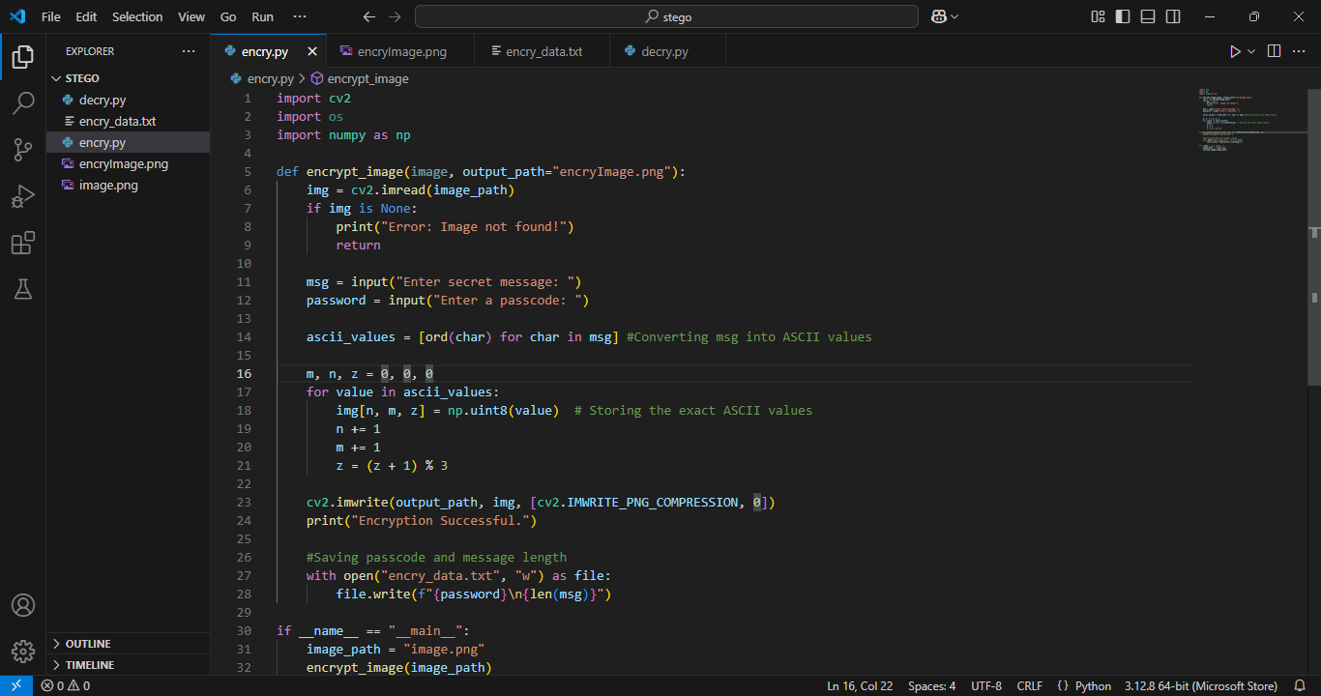
RESULTS

Slide 8
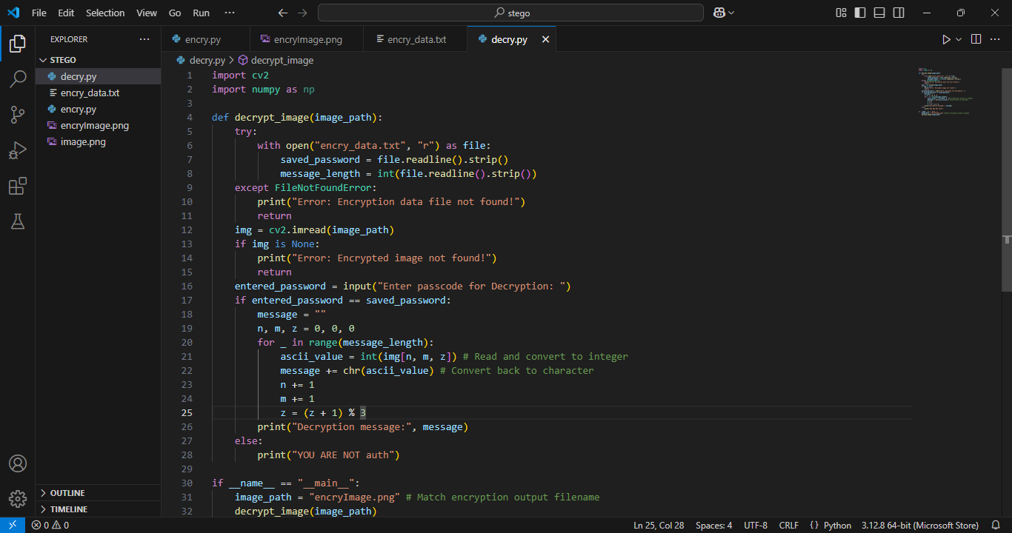

Slide 9
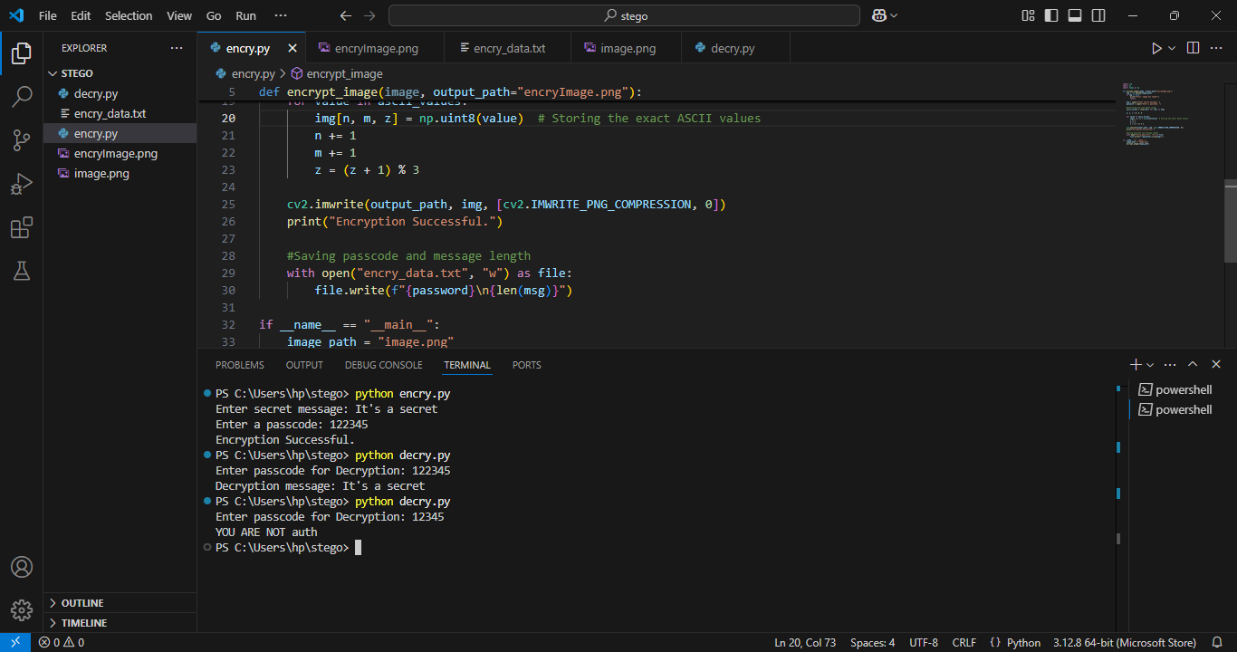

Slide 10
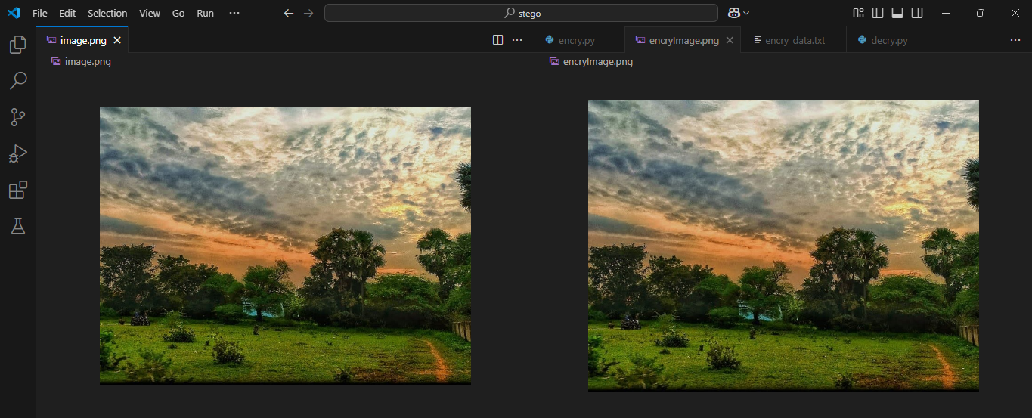

Slide 11
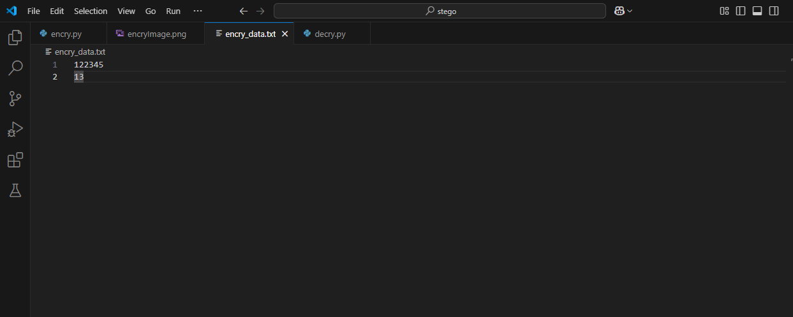

Slide 12
CONCLUSION
The project demonstrates a robust method of hiding data inside images using Python, OpenCV (cv2), NumPy, and OS libraries.
The system allows for both embedding and extracting data with high accuracy.
While the method is simple, it provides a secure way to hide information, and future enhancements can improve encryption and multi-layer security.

Slide 13
GITHUB LINK
https://github.com/selva1342/IBMPROJECTS
Readme file is attached .

Slide 14
FUTURE SCOPE
Explore using other methods like DCT (Discrete Cosine Transform) or DWT (Discrete Wavelet Transform) for better security and robustness.
Implement techniques to make the embedded data more resistant to steganalysis (detection of hidden data).
Study and implement methods to ensure that data remains intact after image compression, which may otherwise affect the hidden data.

Slide 15
THANK YOU

